Slide 1
HELLO!
Welcome to Selenium IDE
E: sangbui@digitest.vn
S: thanhsang.skype
W: sangbui.com

Slide 2
Selenium is a free (open source) Automated testing for web applications Across browsers and platforms.

Slide 3
Selenium is not just a single tool but a suite of software's

Slide 4
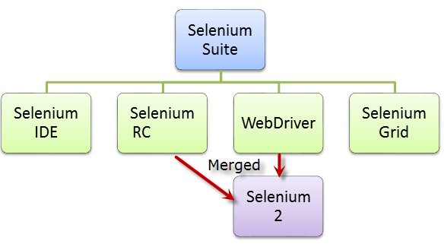

Slide 5
Selenium IDE: Firefox add-on that you can only use in creating simple test cases and test suites.
Selenium Remote Control (Selenium 1): The first Selenium tool that allowed users to use programming languages in creating complex tests.
WebDriver: Allows your test scripts to communicate directly to the browser, controlling it from the OS level.
Selenium Grid: Running multiple tests across different browsers, operating systems, and machines in parallel.

Slide 6
Selenium IDE: Firefox add-on that you can only use in creating simple test cases and test suites.
Selenium Remote Control (Selenium 1): The first Selenium tool that allowed users to use programming languages in creating complex tests.
WebDriver: Allows your test scripts to communicate directly to the browser, controlling it from the OS level.
Selenium Grid: Running multiple tests across different browsers, operating systems, and machines in parallel.

Slide 7
Selenium IDE
1) Introduction
2) Install IDE, FireBug & FirePath
4) IDE overview
5) Locators in Selenium IDE
6) Verify Presence of an Element

Slide 8
Selenium IDE
Selenium IDE is an Integrated Development Environment for Selenium scripts. It is a Firefox extension, and allows you to record, edit, and debug tests.
Selenium IDE should only be used as a prototyping tool.
Notes:
simple test cases and test suites

Slide 9
